Slide 1
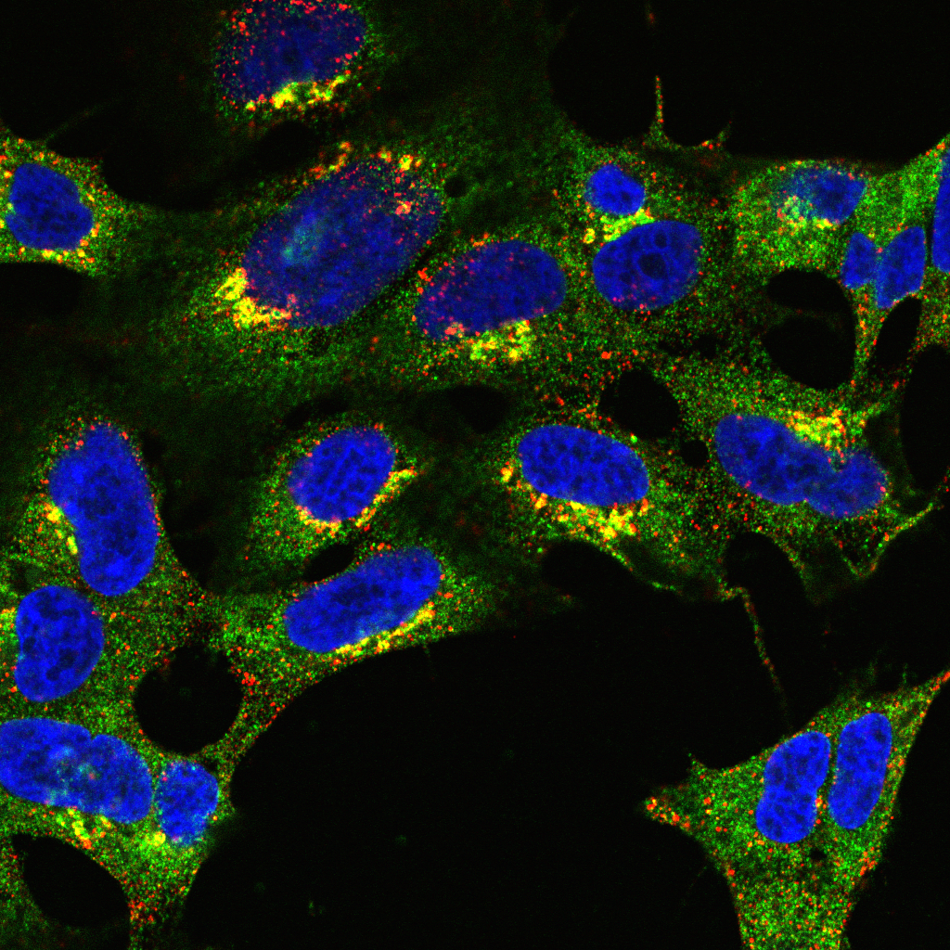
Introduction to colocalisation analysis Part 1

Slide 3
Part 1:
What is colocalisation?
How do we measure it?
Part 2:
Intensity-based localisation
Part 3:
Object-based localisation
Ongoing:
?

Slide 4
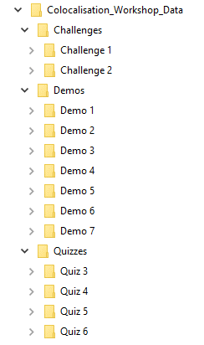
4 Teams
6 Quizzes - 11 Points in Total
2 Challenges - 14 Points in Total

Slide 5
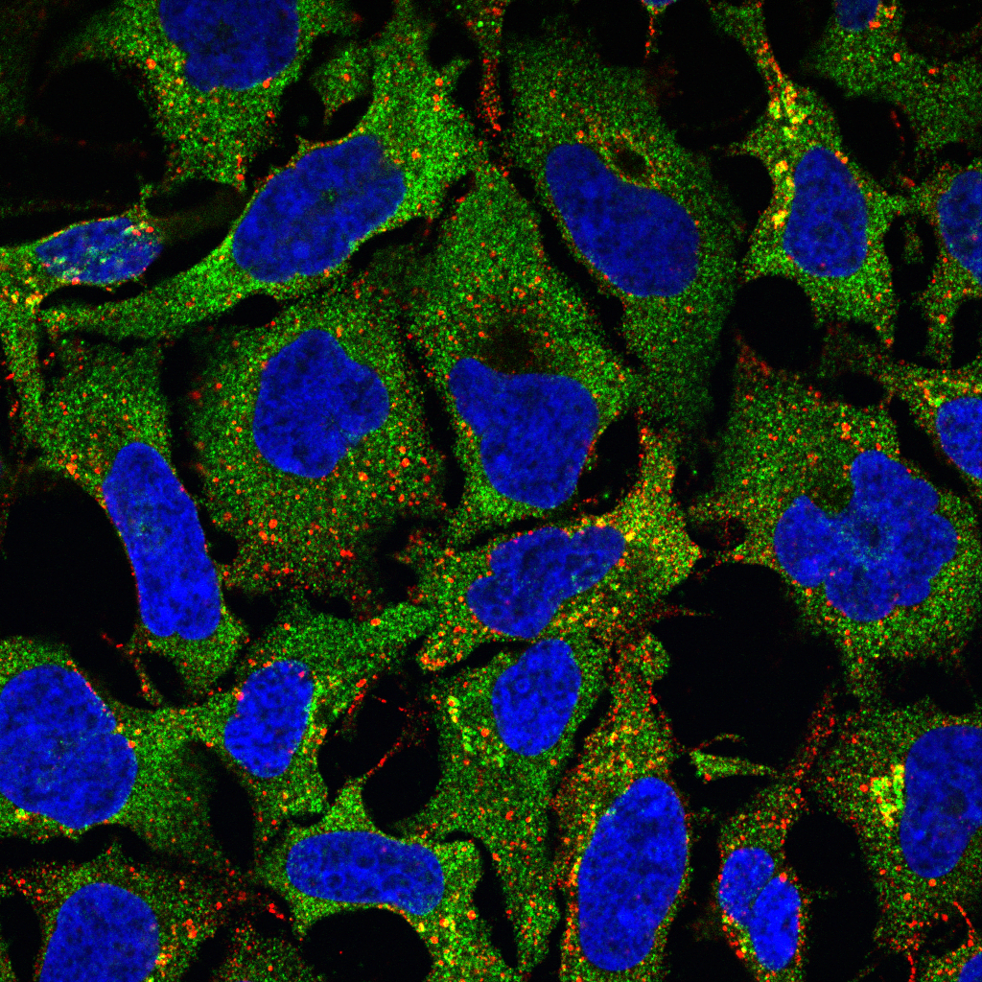
What do we mean by colocalisation?

Slide 6
What do we mean by colocalisation?
Typically refers to one of two things:
Biologists’ Definition: Co-occurrence of two or more proteins
Statisticians’ Definition: Correlation of two fluorescent signals
A
B

Slide 7
Biologists’ assessment often visual
Simplest Case:
Merge two fluorescence pseudo-coloured images
Assess whether different wavelengths are present in same pixels
E.g. Red + Green = Yellow
Problem:
Intermediate colour (e.g. yellow) only visible if probes overlap in similar proportions

Slide 8
“Colour” is highly subjective

Slide 9


Which nucleus is brighter?
Same Intensity

Slide 10
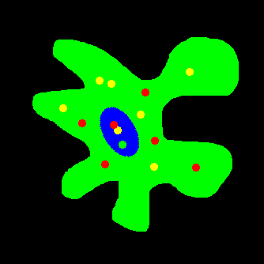
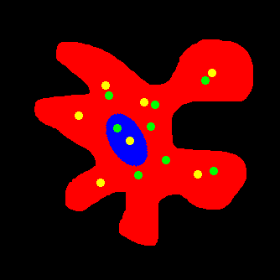
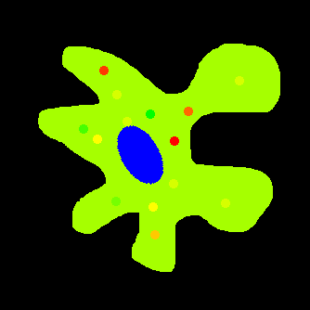

Slide 11

Quiz 1: How many colours Are There?

Slide 12
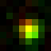
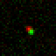
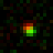
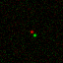
Co-Occurance never actually happens!
Confocal
There is no such thing as “colocalisation”!
Deconvolved Widefield
Super-Resolution

Slide 13
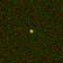
what if DOTs overlap at max resolution?
Fluorophores reside within same volume.
Volume at least one order of magnitude larger than protein complexes

Slide 14
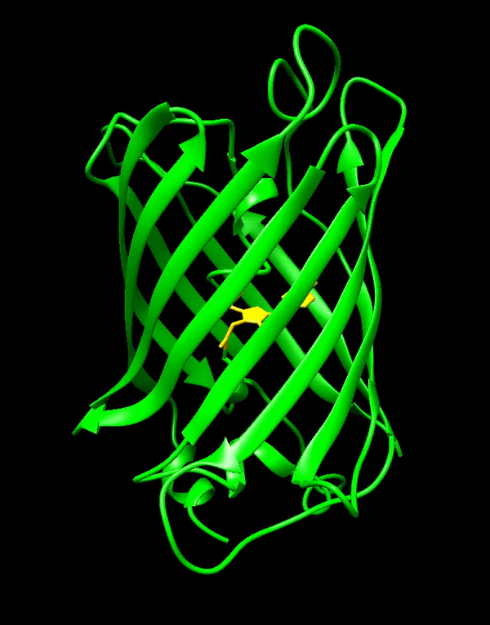
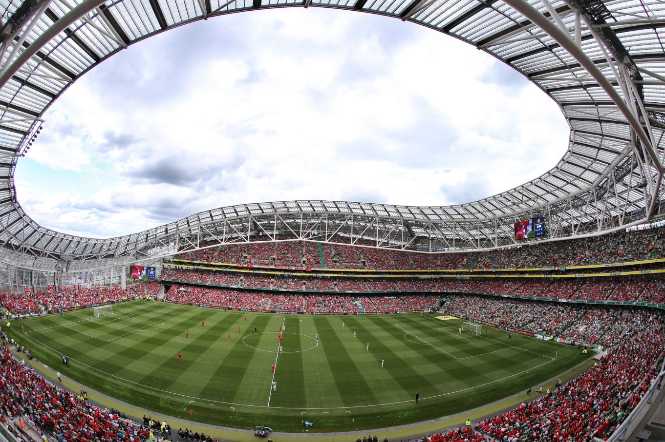
To put that in perspective…
Imaging volume in confocal microscopy approx. 250 x 250 x 750 nm
Imaging volume can accommodate 2,500 GFP molecules!
42 Å
24 Å

Slide 15
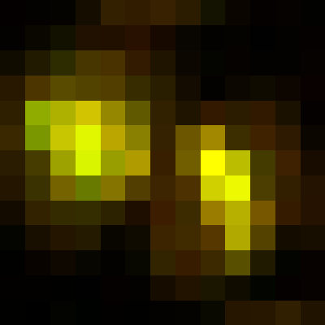
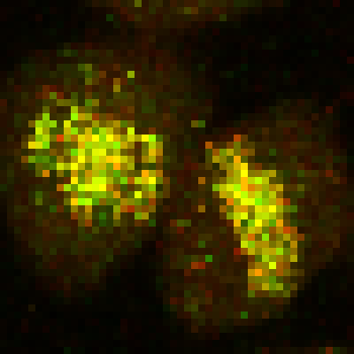
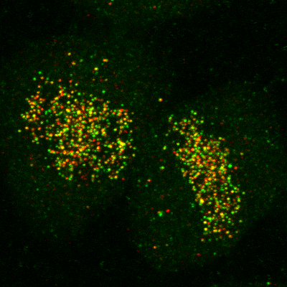
Correlation is not causation
Colocalisation does not imply interaction
Non-colocalisation probably implies no interaction
Dividing line between colocalisation and non-colocalisation is arbitrary
Extent of colocalisation decreases with increasing spatial resolution
Demmerle et al., Nat Protocols, 2017
Relative Localisation
Correlation Analysis

Slide 16
Quiz 2
Which of the following determines the resolution of an image?
Magnification
Image size
Pixel size
Microscope type (widefield, confocal, light-sheet, etc.)
None of the above

Slide 17
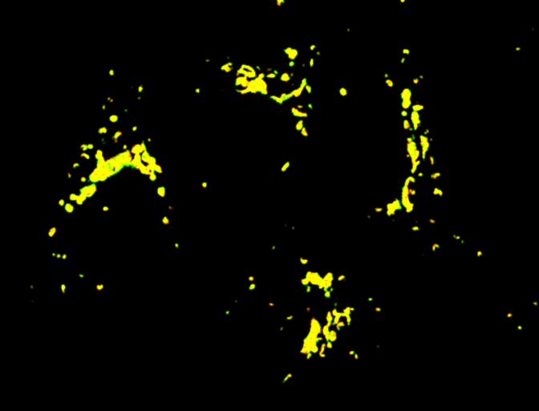
To Summarise: “Colocalisation” means different things to different people…
Red + Green = Yellow?
Co-occurrence:
Molecules present in a region
No concentration relationship
Correlation analysis:
Stoichiometric relationship between molecules
No spatial information
A
B

Slide 18
What is Quantitative Colocalisation?
“Under the conditions of proportional co-distribution, points of the scatterplot cluster around a straight line, whose slope reflects the ratio of the fluorescence of the two probes.”
Dunn et al., Am J Physiol Cell Physiol, 2011

Slide 19
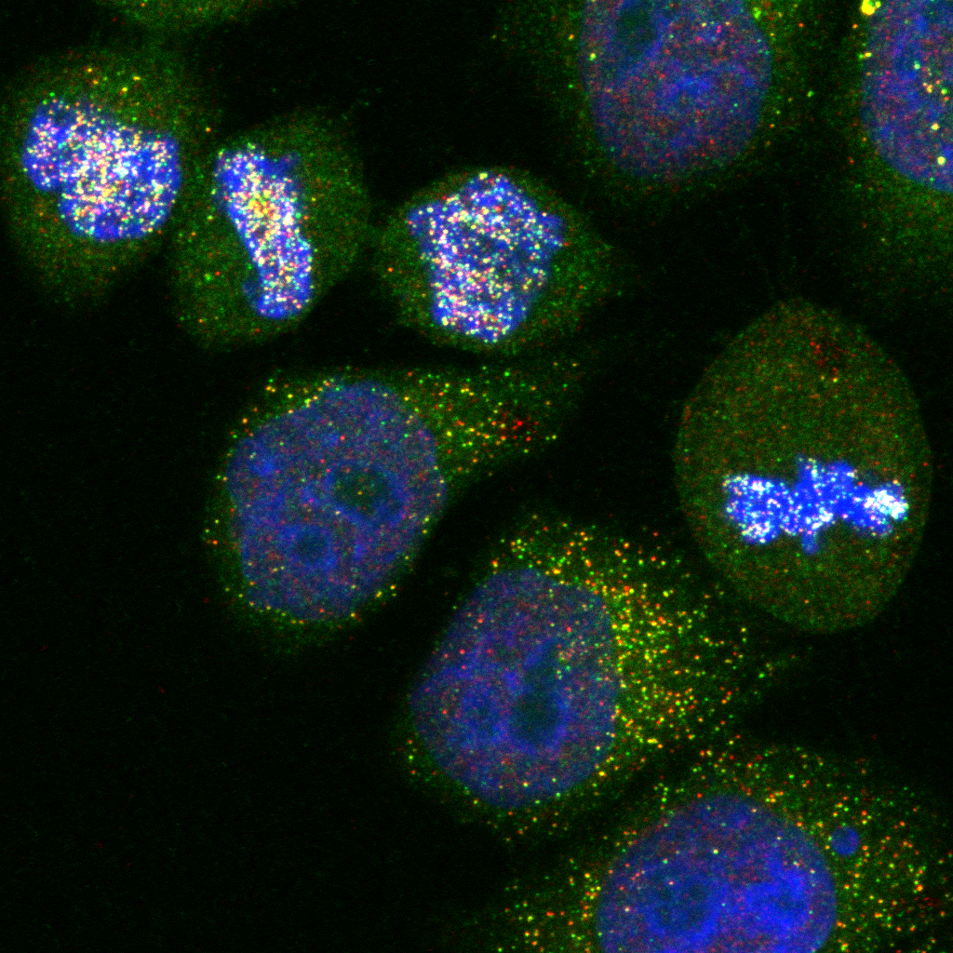
Two criteria must be met:
Co-occurrence - spatial overlap of probes
Correlation - probes are co-distributed
Distribution may overlap, but not proportionally
DAPI will overlap with nuclear proteins, but will unlikely be proportional

Slide 20
Correlative/intensity-based approaches

Slide 21
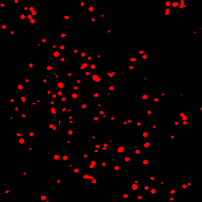
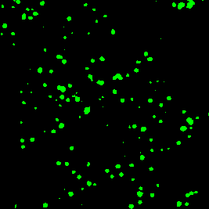
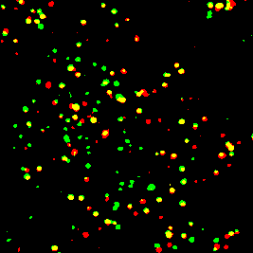
Intensity-based correlation coefficients
Pearsons
Analysis of signal correlation
Spearmans
Similar to Pearsons
Less sensitive to outliers
Manders
Analysis of signal overlap

Slide 22





Pearson’s correlation coefficient
$$P_{cc}=\frac{\sum_{i}{(R_{i}−\overline{R})×(G_{i}−\overline{G})}}{\sqrt{\sum_{i}{{(R_{i}−\overline{R})}^{2}×}\sum_{i}{{(G_{i}−\overline{G})}^{2}}}}$$
$$\sum_{i}{(R_{i}−\overline{R})×(G_{i}−\overline{G})}$$
$\overline{R}=$ Mean red intensity in whole image
$R_{i}−\overline{R}=$ Difference between each red pixel and the mean red intensity
$$\sqrt{\sum_{i}{{(R_{i}−\overline{R})}^{2}×}\sum_{i}{{(G_{i}−\overline{G})}^{2}}}$$
$\sum_{i}{{(R_{i}−\overline{R})}^{2}=}$ Variance in red signal
$$σ_{R+G}=\sqrt{{σ_{R}}^{2}×{σ_{G}}^{2}}$$
The coefficient is normalised to the standard deviation across the two channels to ensure that values range from -1 to +1

Slide 23

Pearson’s correlation coefficient
-74.4 | X | -74.5 | = | 5543
74.4 | X | 130.1 | = | 9683
65.9 | X | 15.6 | = | 1026
-65.9 | X | -71.2 | = | 4690
113.3
Mean: 113.1
 |  |  |  | 20944
47.8 | 252.4
137.9 | 51.1
-74.5 | 130.1
15.6 | -71.2
5535 |  | 5550
4343 |  | 16926
4343 |  | 243
5535 |  | 5069
122.3
Mean: 122.3
19751 |  | 27788
If two targets are functionally related, their abundances will be predictably related
$$P_{cc}=\frac{20944}{\sqrt{19751 × 27788}}=0.894$$

Slide 24
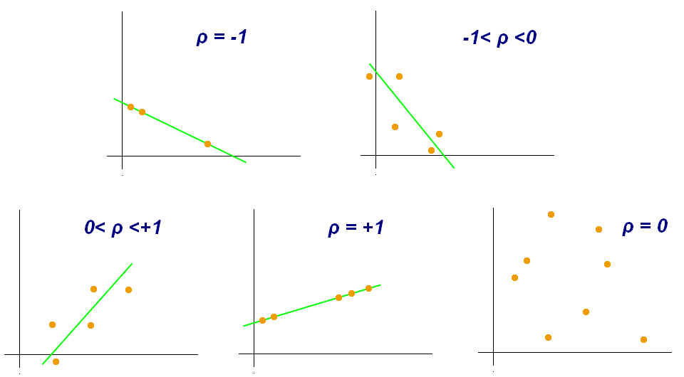
What does this number mean?
To what extent is intensity variation in one channel explained by variation in another…

Slide 26
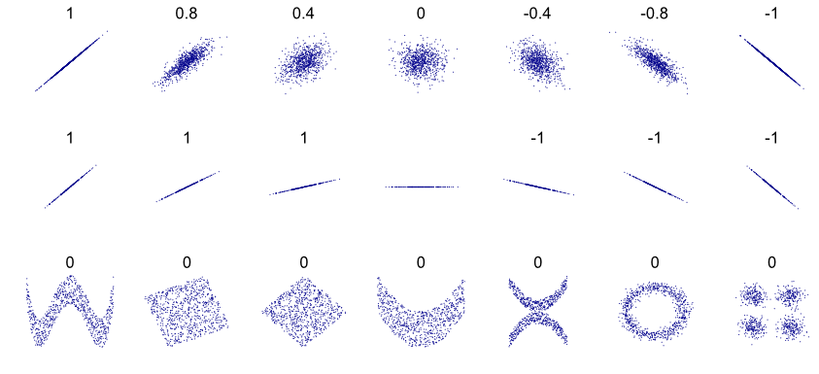
Pearsons can be the same for very different data…

Slide 27
Pearsons can be the same for very different data…
…and intermediate values can be difficult to interpret

Slide 28
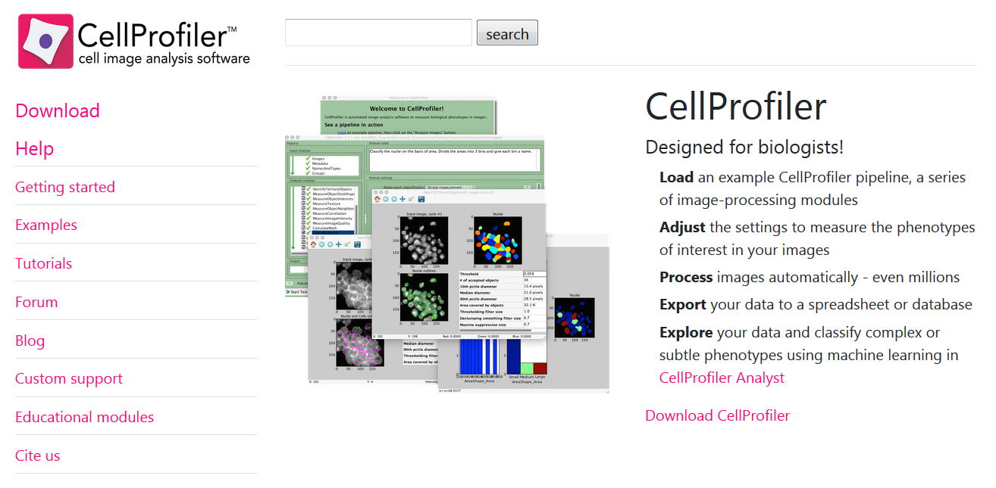
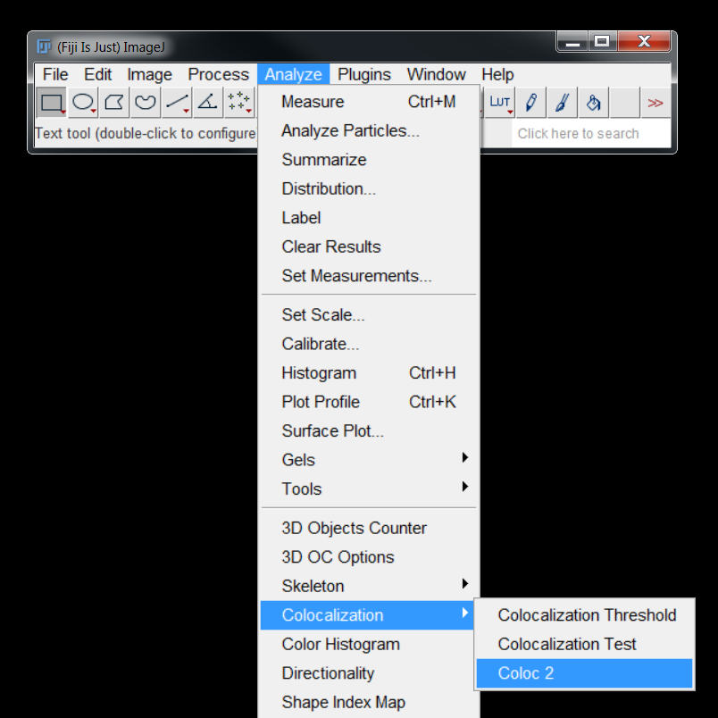
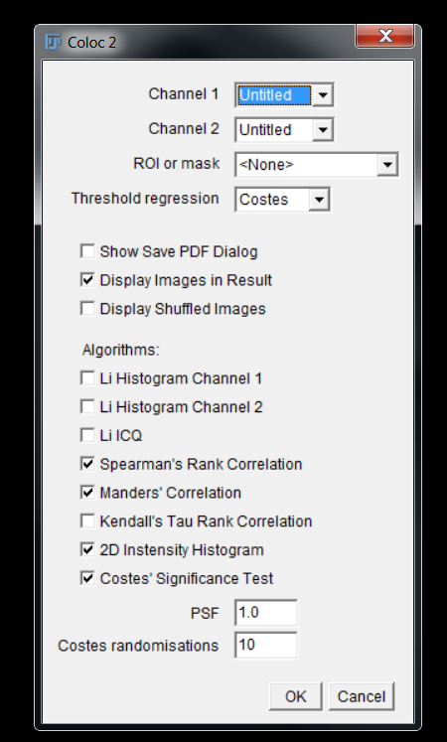
COLOC2 – FIJI Plugin for colocalisation analysis

Slide 29
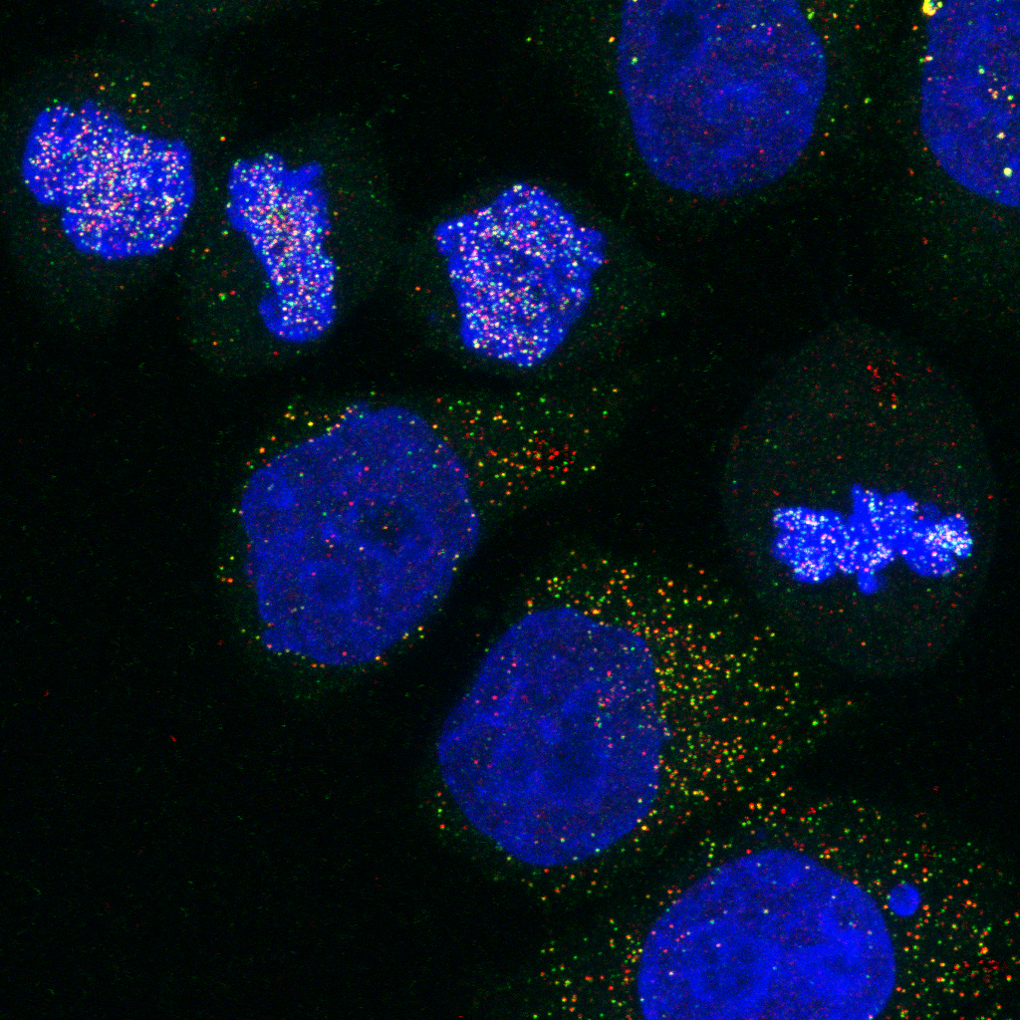
Demo 1: Pearson’S Correlation coefficient

Slide 30
Quiz 3: Pearson’S Correlation coefficient
Open the image in the Quiz 3 folder with Bio-Formats:
Using Coloc2, calculate Pearson’s correlation coefficient for the image

Slide 31
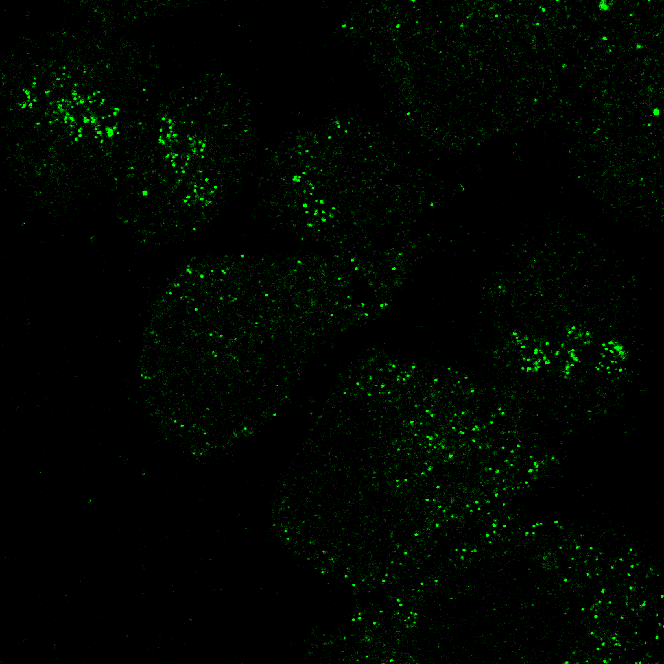
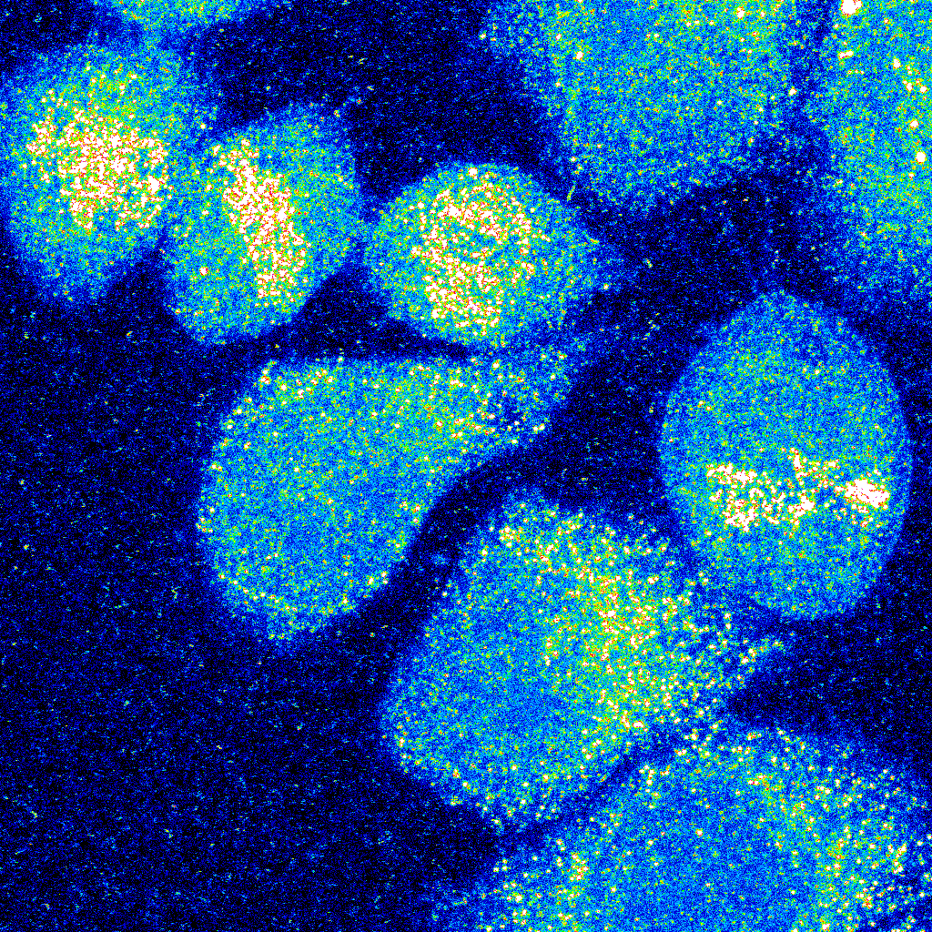
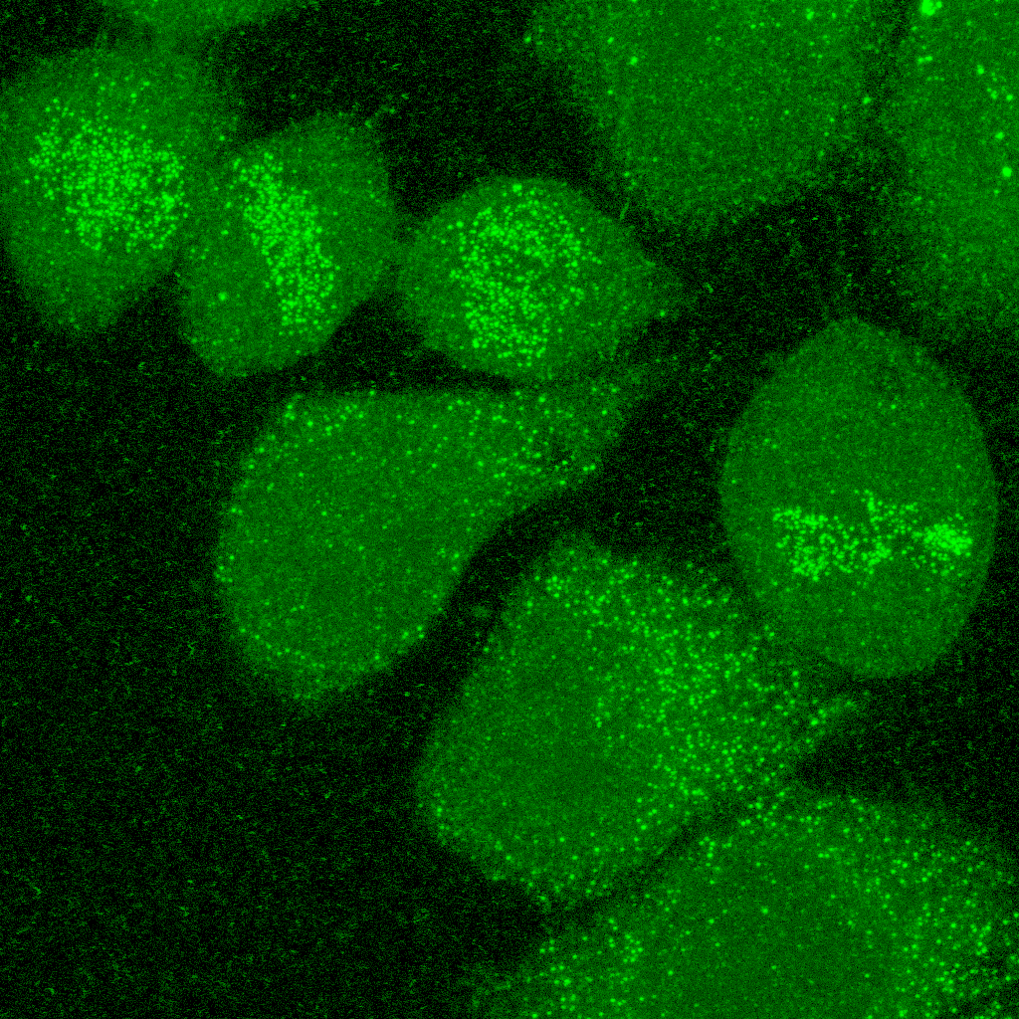
Influence of NOISE & background
“Background” refers to the amount of offset in an image
“Noise” refers to the variability in a measurement
Both have impacts on colocalisation

Slide 32
Background causes spurious results
Quantification of P_{CC} within cells indicates poor association (P_{CC} = 0.16)
When quantified over entire image, P_{CC} = 0.39
Dunn et al., Am J Physiol Cell Physiol, 2011

Slide 33
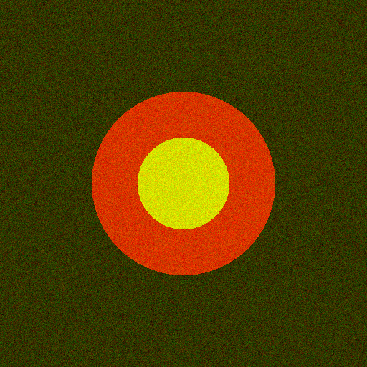
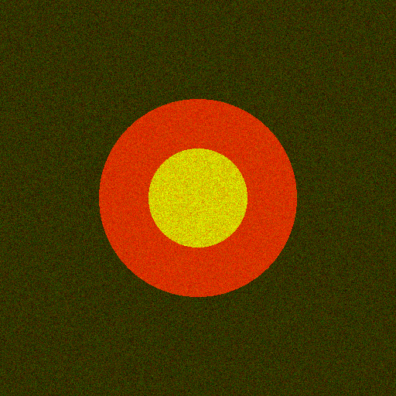
Noise results in “Less” correlation
P_{cc} = 0.41
P_{cc} = 0.33
Sample can exhibit high co-occurrence, but low correlation

Slide 34
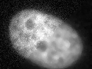
Filtering suppresses Noise
But information is lost!

Slide 35
Demo 2: Influence of background & Noise

Slide 36
Quiz 4: Influence of Background & Noise
Open the images in the Quiz 4 folder with Bio-Formats:
Using Coloc2, calculate Pearson’s correlation coefficient for both images
The images show the same field of view, but the correlation coefficients are different – why?

Slide 37
Pearson’s: Pros & Cons
PROS
CONS
Easy to measure
Broadly applicable
Independent of signal levels
Same amount of signal overlap can have dramatically different P_{CC} values
Intermediate values difficult to interpret
Background pixels artificially inflate P_{CC} values
Empty areas within cells have similar effect
Depends on linear relationship between probe intensities

Slide 38
Spearman’s correlation coefficient
Pearson’s skewed by non-linearity, such as outliers
Spearman’s similar to Pearson’s, but compares ranks rather than values
Red | Green | Rank Red | Rank Green
96 | 93 | 6 | 7
177 | 209 | 3 | 3
41 | 30 | 10 | 10
43 | 94 | 9 | 6
500 | 10000 | 1 | 1
112 | 165 | 4 | 4
102 | 234 | 5 | 2
194 | 75 | 2 | 8
79 | 104 | 7 | 5
64 | 52 | 8 | 9
P_{c} = 0.9
S_{c} = 0.1

Slide 39
Demo 3: Spearman’s Correlation Coefficient

Slide 40
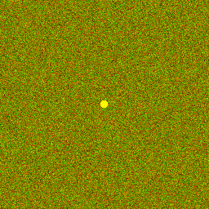
Quiz 5: Spearman’s Correlation Coefficient
Open the images in the Quiz 5 folder with Bio-Formats:
Using Coloc2, calculate Spearman’s and Pearson’s correlation coefficients for both images
Which coefficient is more appropriate to quantify colocalization in these images? Why?

Slide 41
Both measure poorly the quantity that is typically at the heart of most analyses of colocalization in cell biology:
The fraction of one family of objects that localizes with another.

Slide 42
HYBRID approach: Manders Coefficient

Slide 43



Mander’s coefficient
Overlap Coefficient:
$$M_{OC}=\frac{\sum_{i}{(R_{i}×G_{i})}}{\sqrt{\sum_{i}{{R_{i}}^{2}×}\sum_{i}{{G_{i}}^{2}}}}$$
Independent of signal proportionality
Sensitive to co-occurrence, the fraction of pixels with signals from both channels
Colocalisation Coefficient:
$$M_{1}=\frac{\sum_{i}{R_{i,colocal}}}{\sum_{i}{R_{i}}}$$
$$M_{2}=\frac{\sum_{i}{G_{i,colocal}}}{\sum_{i}{G_{i}}}$$
Problem: Image must contain meaningful “zero” values.

Slide 44
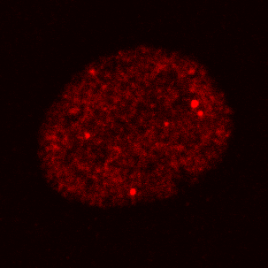
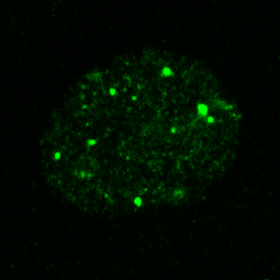
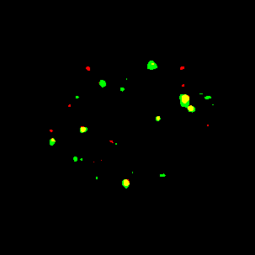
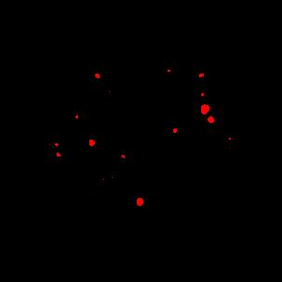
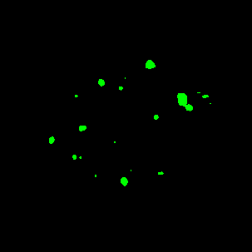
M_{red-green} = 0.59
M_{green-red} = 0.68

Slide 45
Demo 4: Manders’ Correlation Coefficient

